Slide 1
Ketchup
Game 256

Slide 2
Review
Linear Motion
Quaternion
Euler Integration
Inertia
Orientation
Angular Motion

Slide 3
Linear Motion
Do the do in a line.

Slide 4
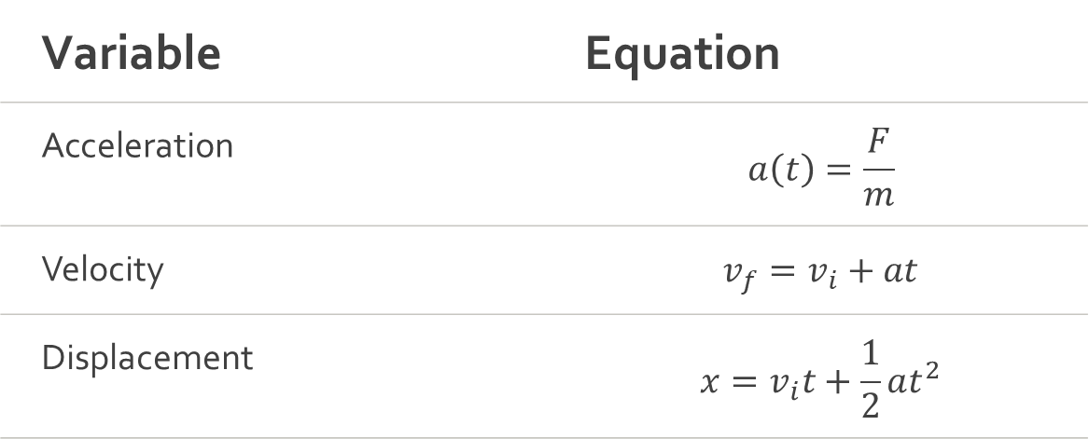
Linear
Motion
Variable | Equation
Acceleration | $$a\left(t\right)=\frac{F}{m}$$
Velocity | $$v_{f}=v_{i}+at$$
Displacement | $$x=v_{i}t+\frac{1}{2}at^{2}$$

Slide 5
Angular Motion
Do the do around the bigger do.

Slide 6
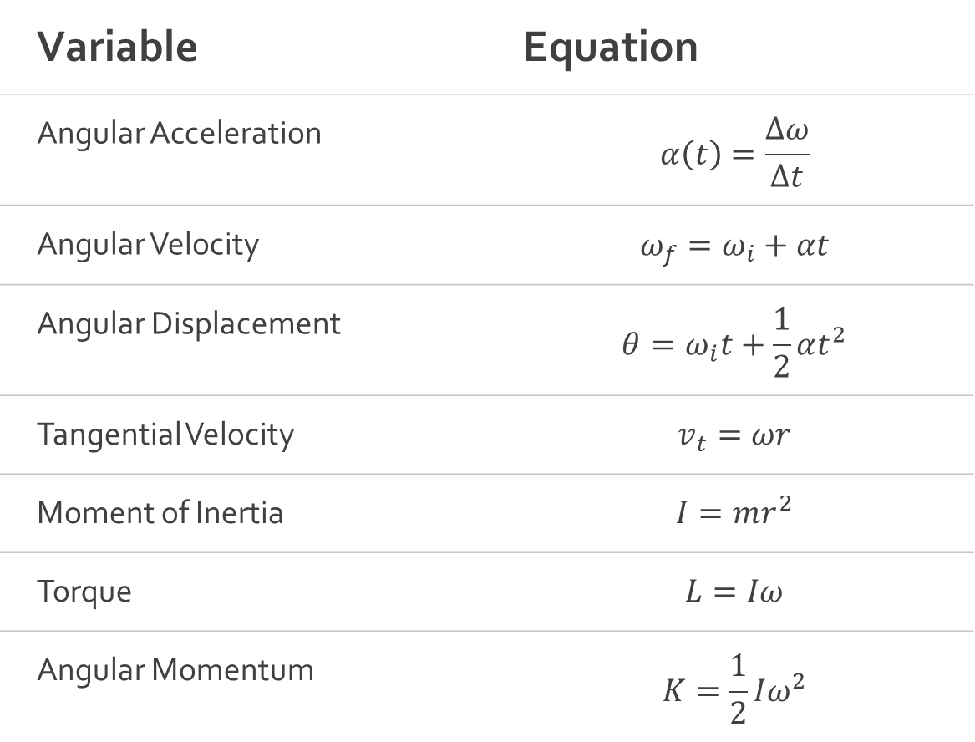
Angular Motion
Variable | Equation
Angular Acceleration | $$α\left(t\right)=\frac{∆ω}{∆t}$$
Angular Velocity | $$ω_{f}=ω_{i}+αt$$
Angular Displacement | $$θ=ω_{i}t+\frac{1}{2}αt^{2}$$
Tangential Velocity | $$v_{t}=ωr$$
Moment of Inertia | $$I=mr^{2}$$
Torque | $$L=Iω$$
Angular Momentum | $$K=\frac{1}{2}Iω^{2}$$

Slide 7
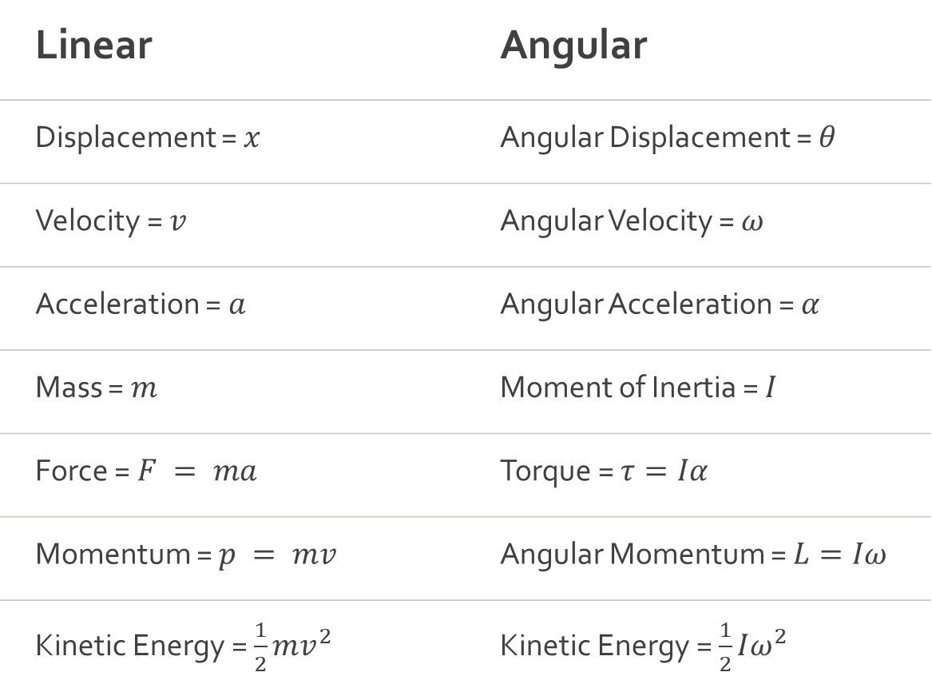
Linear
Meets
Angular
Linear | Angular
Displacement = $x$ | Angular Displacement = $θ$
Velocity = $v$ | Angular Velocity = $ω$
Acceleration = $a$ | Angular Acceleration = $α$
Mass = $m$ | Moment of Inertia = $I$
Force = $F = ma$ | Torque = $τ=Iα$
Momentum = $p = mv$ | Angular Momentum = $L=Iω$
Kinetic Energy = $\frac{1}{2}mv^{2}$ | Kinetic Energy = $\frac{1}{2}Iω^{2}$

Slide 8
Euler Integration
Do the do accurately.

Slide 9

Euler Integration
Explicit
  $x+=v∆t$
  $v+=a∆t$
Semi-Implicit
  $v+=a∆t$
  $x+=v∆t$

Slide 10
Integrations
Explicit Euler
Semi-Implicit Euler
RK4
Verlet Integration

Slide 11
Orientation
Describe how the do faces.

Slide 12

Orientation
XYZ (+y up) $\left[\begin{matrix}pitch & yaw & roll\end{matrix}\right]$
XYZ (+z up) $\left[\begin{matrix}pitch & roll & yaw\end{matrix}\right]$
X Rotation $\left[\begin{matrix}1 & 0 & 0 \\ 0 & cosθ & −sinθ \\ 0 & sinθ & cosθ\end{matrix}\right]$
Y Rotation $\left[\begin{matrix}cosθ & 0 & sinθ \\ 0 & 1 & 0 \\ −sinθ & 0 & cosθ\end{matrix}\right]$
Z Rotation $\left[\begin{matrix}cosθ & −sinθ & 0 \\ sinθ & cosθ & 0 \\ 0 & 0 & 1\end{matrix}\right]$
Quaternion $\left[\begin{matrix}w & \left[\begin{matrix}x & y & z\end{matrix}\right]\end{matrix}\right]$

Slide 13
Quaternion
The do becomes 4do.

Slide 14

Quaternion
$q=cos\frac{θ}{2}+Asin\frac{θ}{2}$
$a+bi+cj+dk$
i,j,k are all imaginary units.

Slide 15

Imaginary Unit
$x^{2}=−1$
$i=\sqrt{−1}$

Slide 16

Quaternion
Rotation
$φ_{rotation}\left(P\right)=qPq^{−1}$ Sandwich. mmm

Slide 17
Rotational Inertia Tensor
How resistant to spinning is the do

Slide 18

Rotational
Inertia
Tensor
1D $I=\left[x\right]$
2D $I=\left[\begin{matrix}x & y\end{matrix}\right]$
3D $I=\left[\begin{matrix}xx & −xy & −xz \\ −yx & yy & −yz \\ −zx & −zy & zz\end{matrix}\right]$

Slide 19

Rotational
Inertia
Tensor
$ω_{f}=ω_{i}+I^{−1}τt$ $I^{−1}$ must be in world space.
$I_{w}=RI_{o}R^{T}$ Sandwich. mmm

Slide 20
Fin

